Slide 1
Chapter 4
PUBLIC BLOCKCHAIN SYSTEM

Slide 2
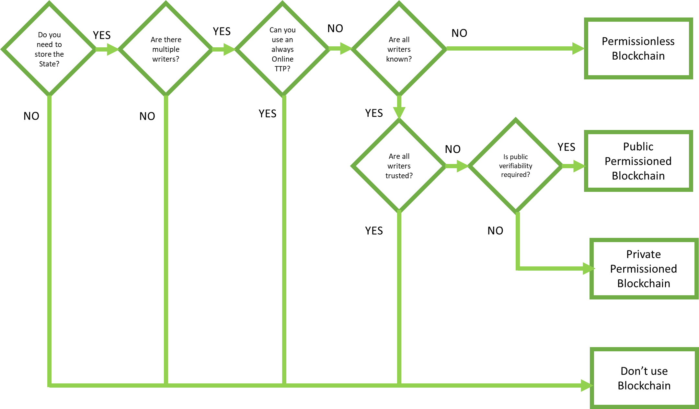

When to use what type of Blockchain?

Slide 3
Blockchain Layers
Layer 1
(Technology)
BLOCKCHAIN
Layer 2
(Protocol/Coin)
BITCOIN
ETHEREUM
RIPPLE
Layer 3
(Token)
X
TRX, SNT, PPT, PNB
X

Slide 4
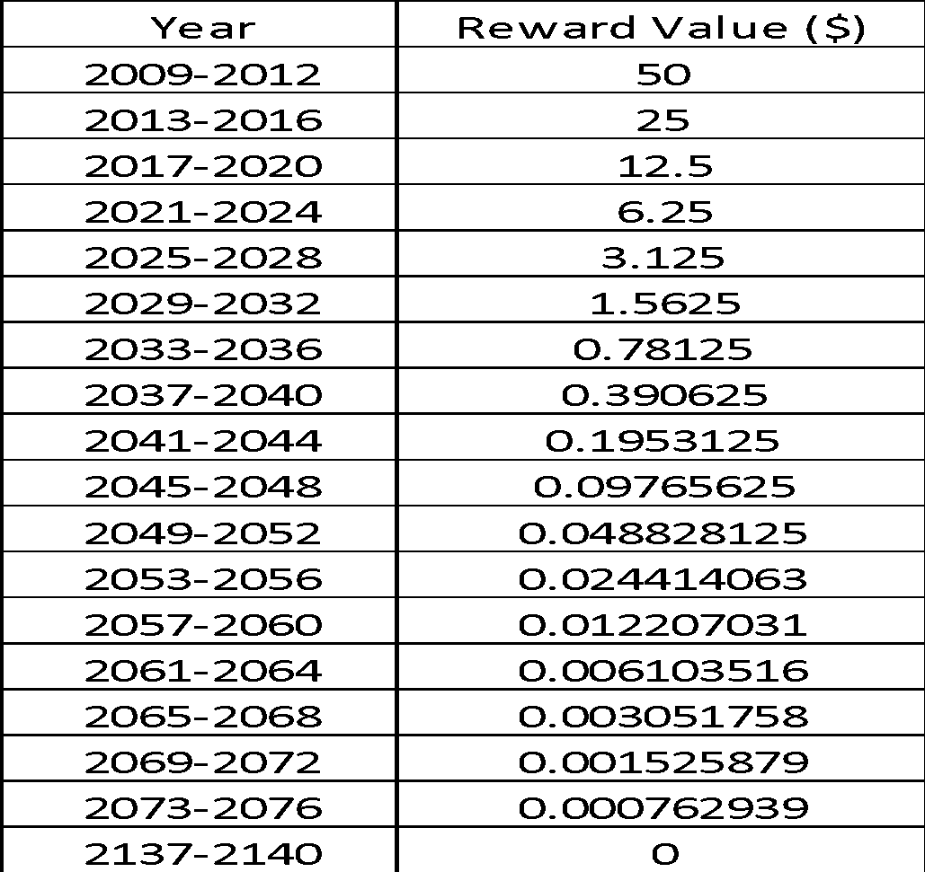
Bitcoin Reward Value over the Years

Slide 5
Simplified Bitcoin Blocks
Block 1 Header
Block 2 Header
Block 3 Header
Hash of Previous Block Header
Hash of Previous Block Header
Hash of Previous Block Header
Merkle Root
Merkle Root
Merkle Root
Block 1 Transactions
Block 2 Transactions
Block 3 Transactions

Slide 6
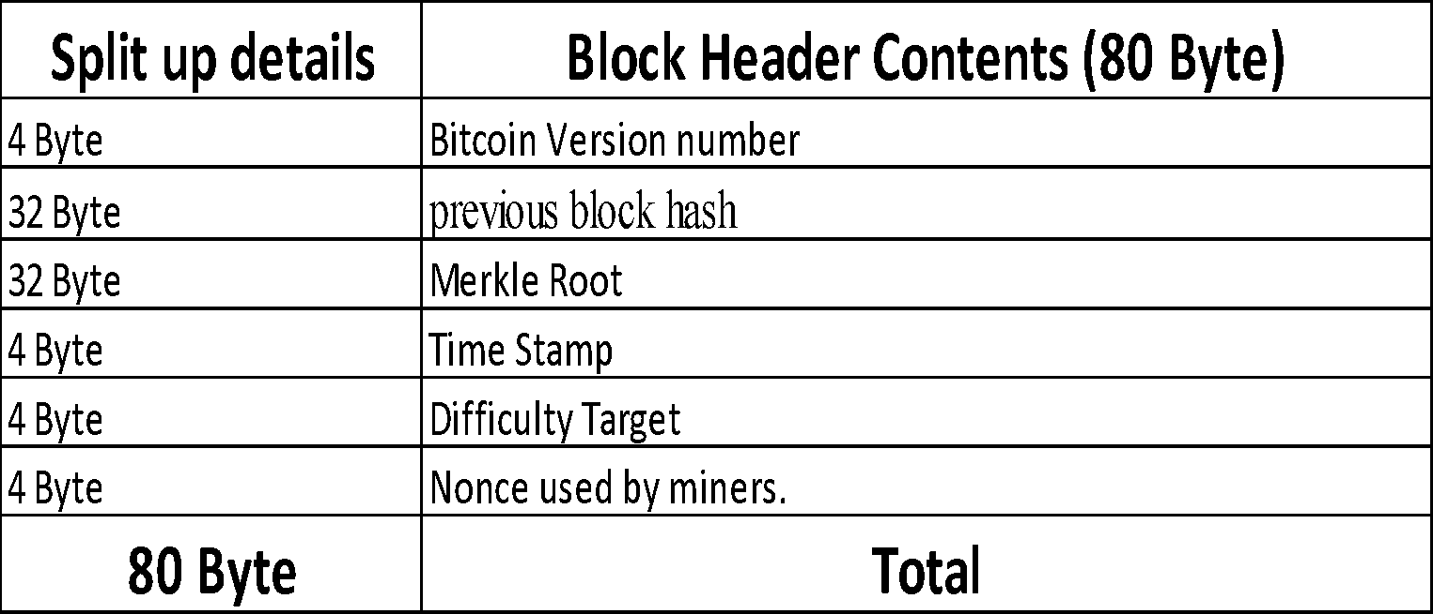
Contents of Bitcoin Block Header

Slide 7
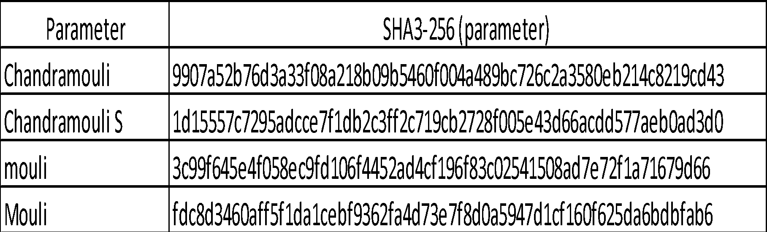
SHA3-256 Examples

Slide 8
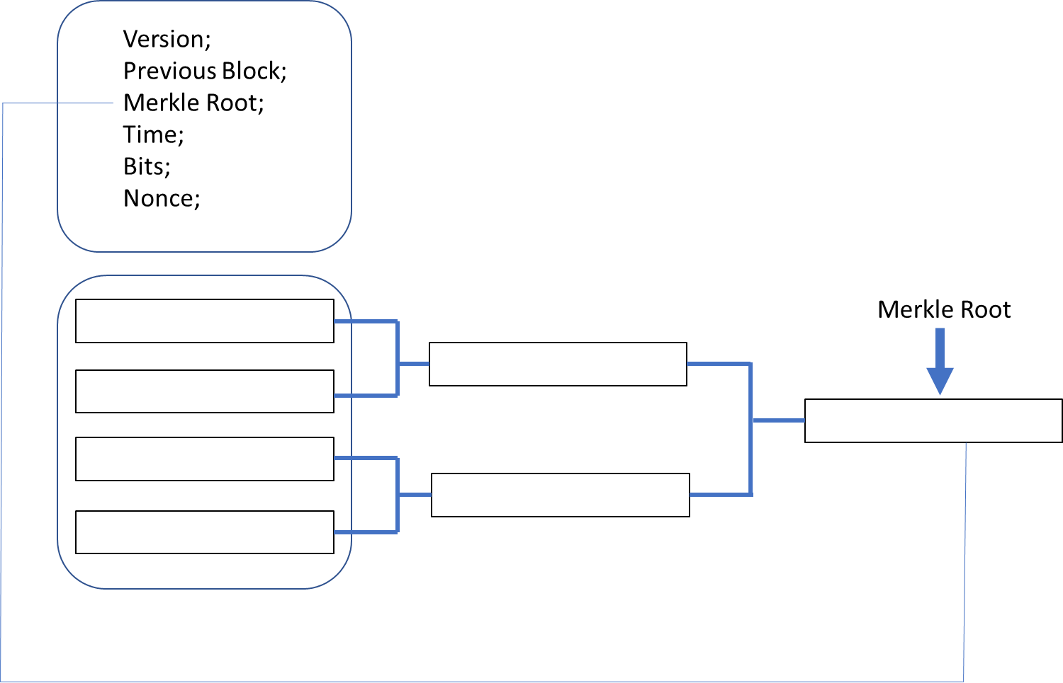
Merkle Root Creation

Slide 9
Hashcash Mapping
Hash of the previous block
Nonce 1
Block of transactions
SHA-256()
0000557c7295adcce7f1db2c3ff2c719cb2728f005e43d66acdd577aeb0ad3d0

Slide 10

Memory Pool
MEMPOOL
MEMPOOL
DA3B430 Fees: 0.00013 BTC
DA3B430 Fees: 0.00013 BTC
C92C481 Fees: 0.00023 BTC
C92C481 Fees: 0.00023 BTC
DA3B430 Fees: 0.0013 BTC
DA3B430 Fees: 0.0013 BTC
9D8B466 Fees: 0.0093 BTC
9D8B466 Fees: 0.0093 BTC
783BB08 Fees: 0.0139 BTC
783BB08 Fees: 0.0139 BTC
261DB27 Fees: 0.0122 BTC
261DB27 Fees: 0.0122 BTC
1505A49 Fees: 0.0111 BTC
1505A49 Fees: 0.0111 BTC
9728D80 Fees: 0.0021 BTC
9728D80 Fees: 0.0021 BTC
1051C02 Fees: 0.1233 BTC
1051C02 Fees: 0.1233 BTC

Slide 11
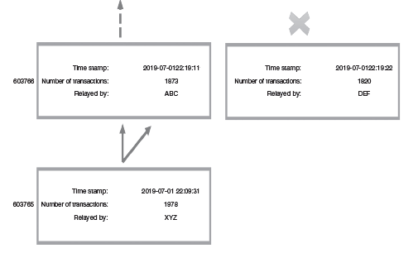
Fork

Slide 12
Bitcoin Transactions
Transaction 0
Version
Inputs
Outputs
Lock time
Transaction 1
Version
Inputs
Outputs
Lock time

Slide 13
Tx (Input)
TX (0)
TX (1)
TX (INPUT)
TX (2)
TX (3)

Slide 14
Tx (Output)
TX (OUTPUT)
TX (INPUT)
CHANGE
(Left over)

Slide 15
UTXOs
Murray sent Monika 0.6 BTC
Anan sent Monika 0.5 BTC
UTXOs
Babi sent Monika 0.3 BTC
Karin sent Monika 0.2 BTC

Slide 16
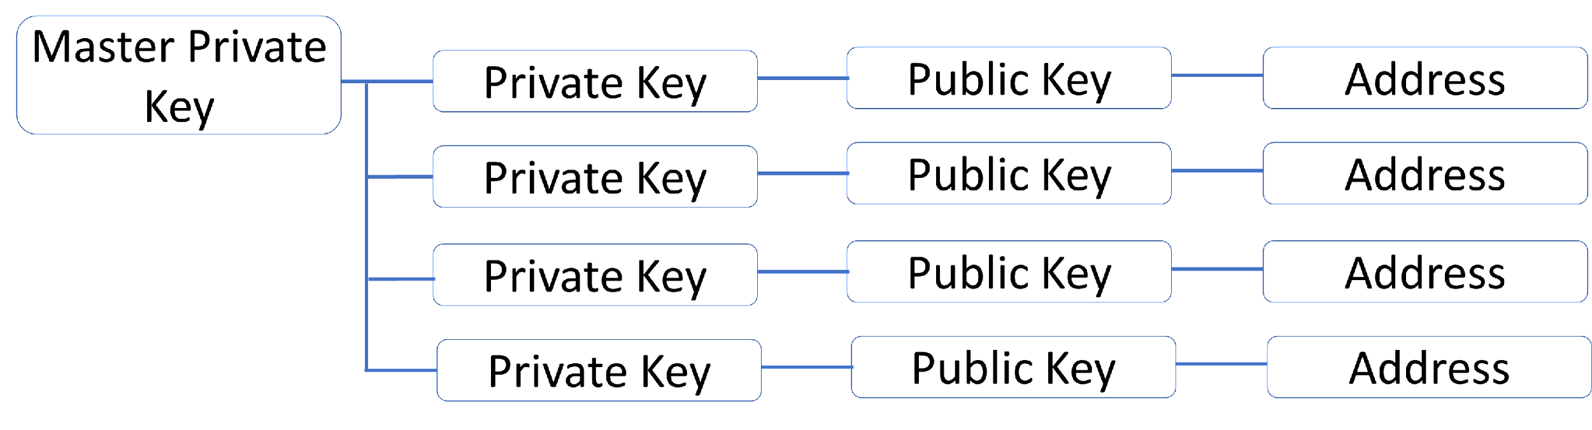
Master Private Key

Slide 17
Public Vs. Private Keys
Sender’s
Private Key
Receiver’s
Public Key
Receiver’s
Private Key
Sender’s
Public Key

Slide 18
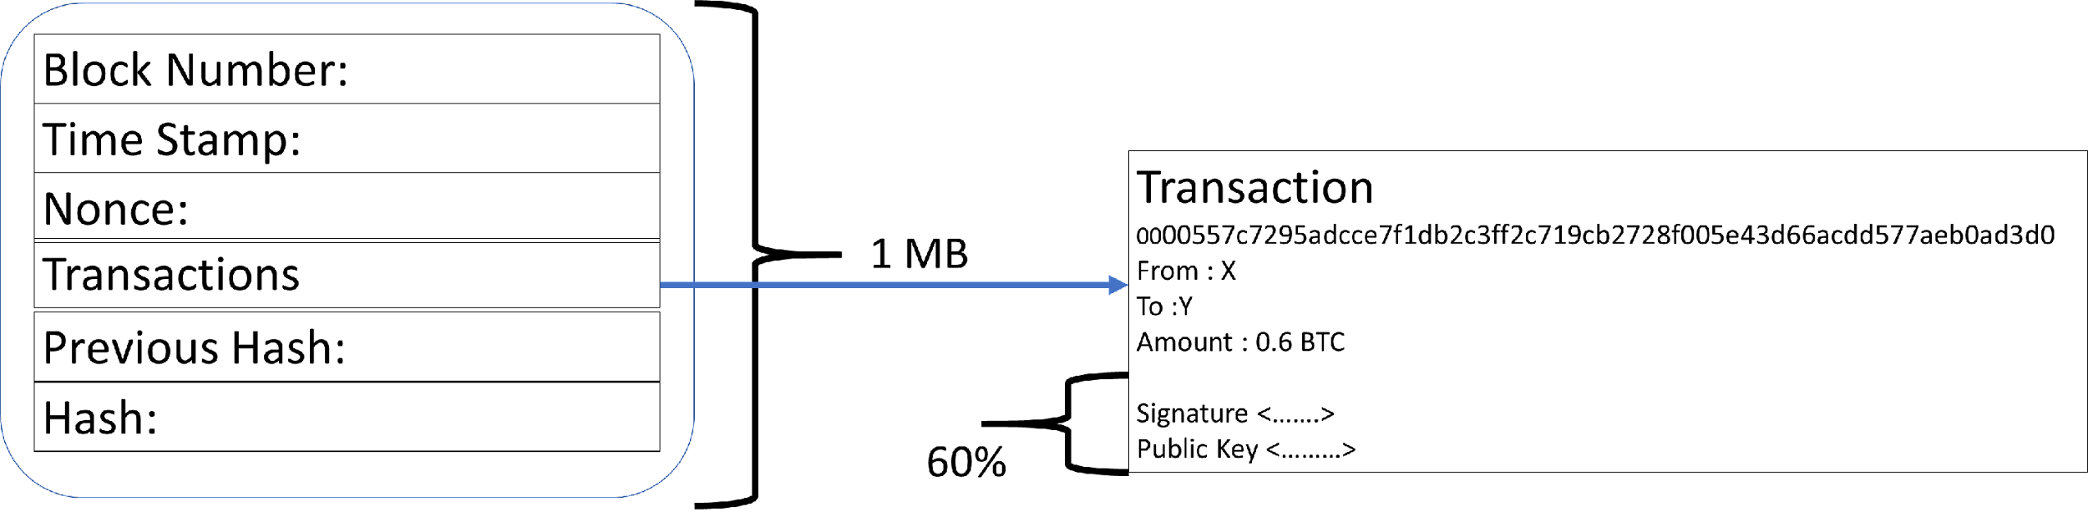
SGWT

Slide 19
Common Characteristics of Bitcoin Scripts
Simple to execute
Lightweight (does not rely on other software packages)
Less computing energy
Built for bitcoin
Uses cryptography (Hashes, Signature verification)
Stack-based
No loops
Conditional statements supported (If statements)
Validation of multiple nodes supported (MULTISIG instruction)

Slide 20
Common Characteristics of Bitcoin Scripts

Slide 21
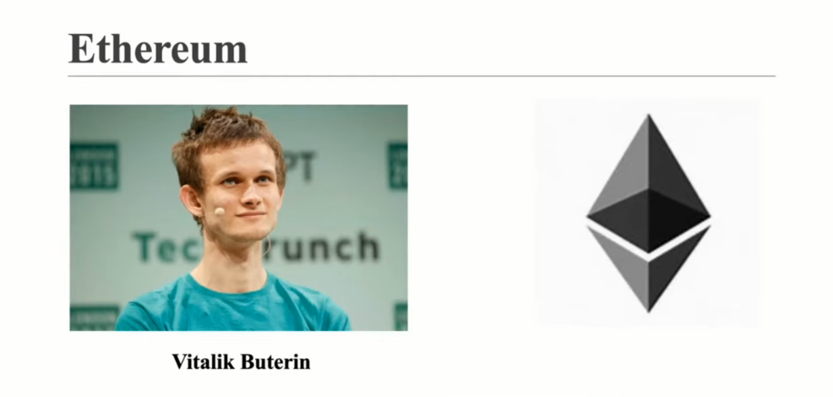

Slide 22
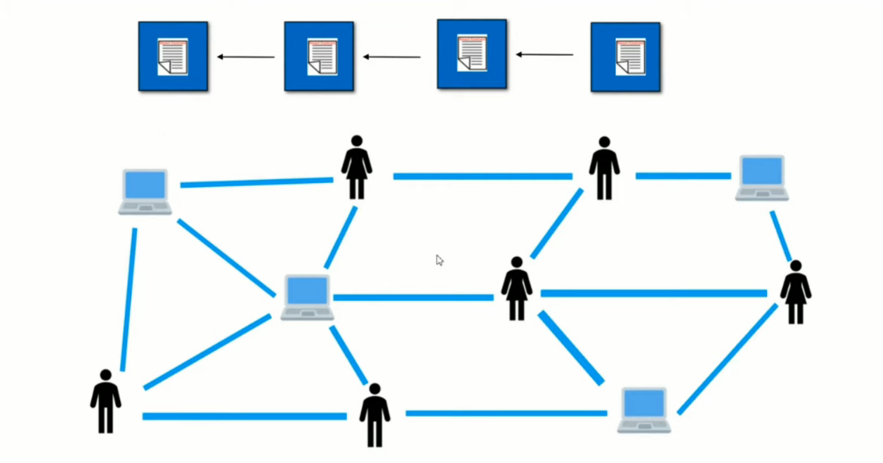

Slide 23
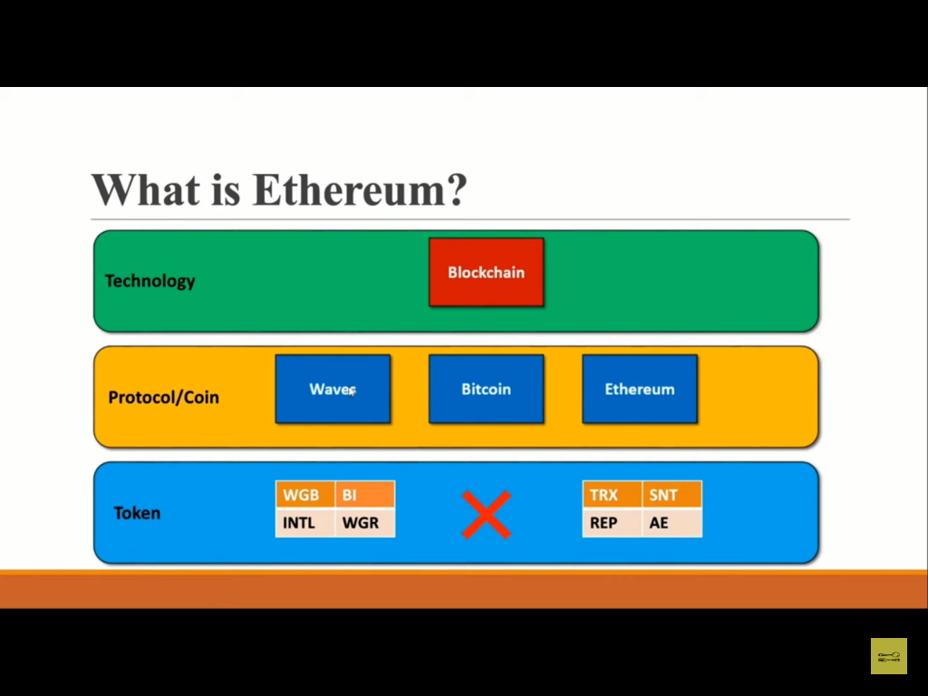

Slide 24
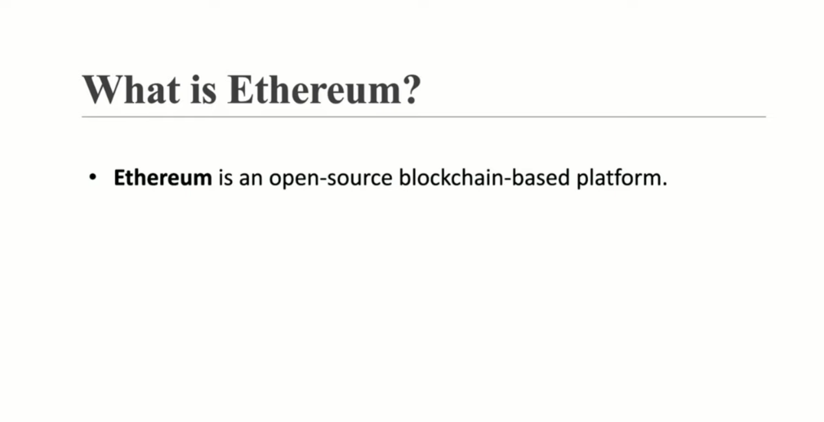

Slide 25
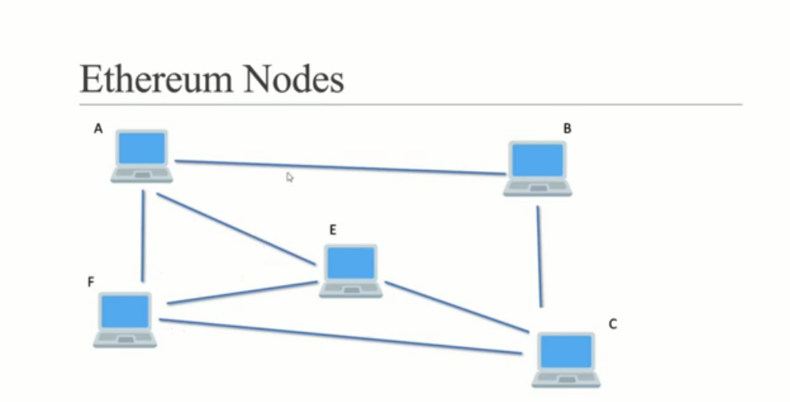

Slide 26
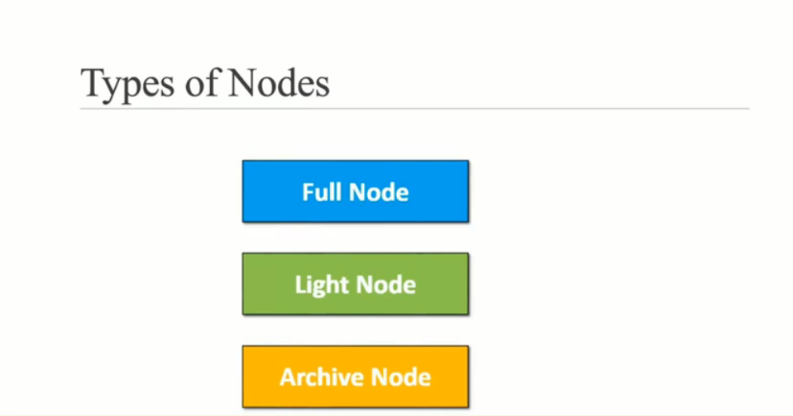

Slide 27
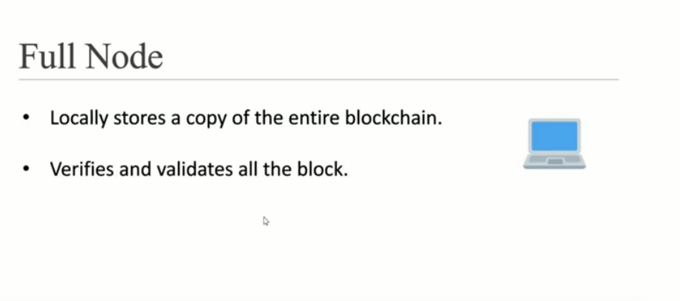

Slide 28
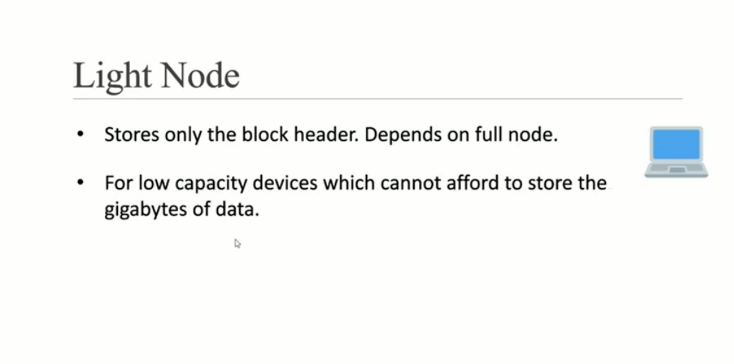

Slide 29
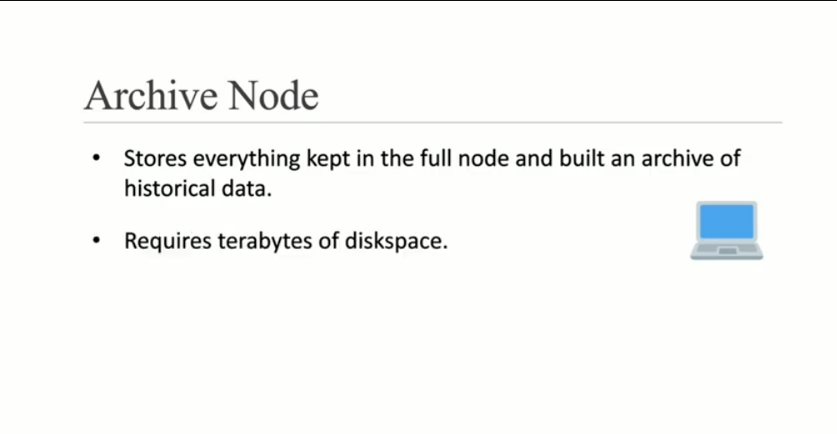

Slide 30
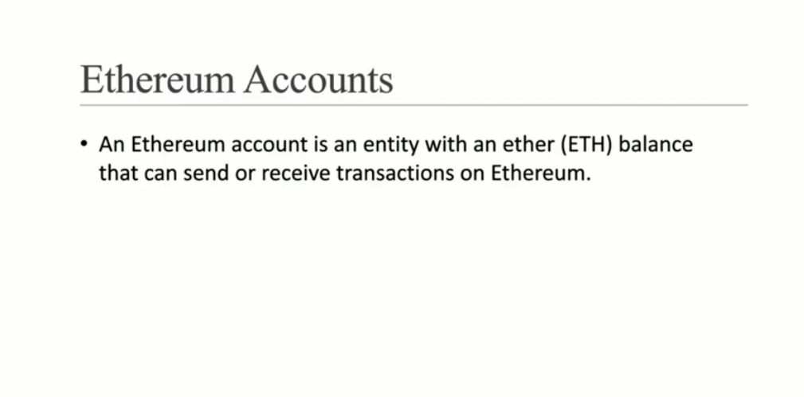

Slide 31
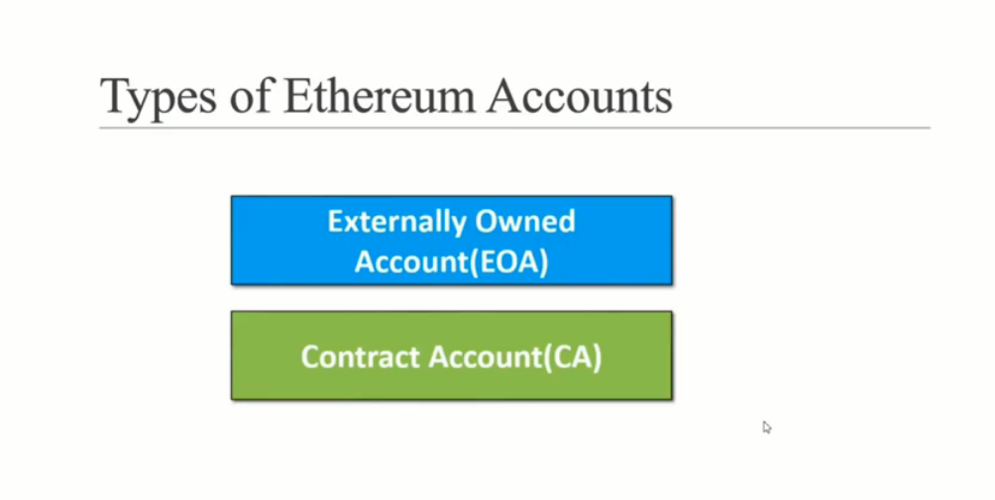

Slide 32
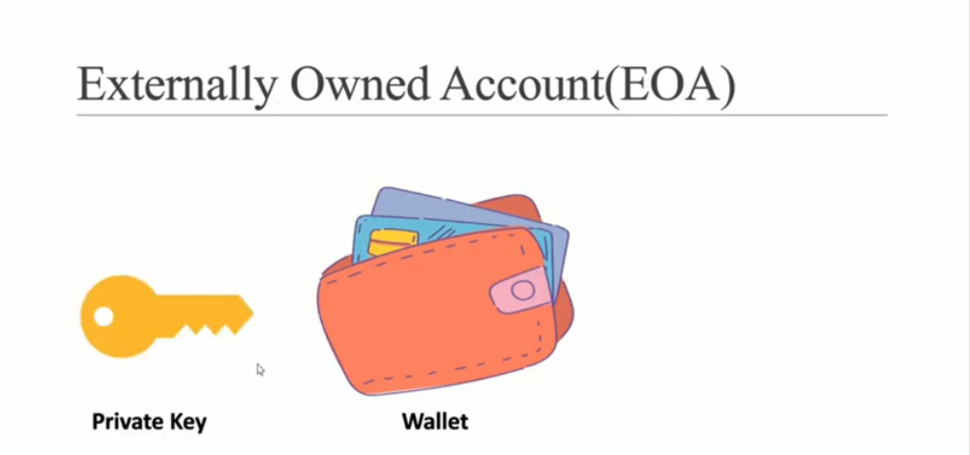

Slide 33
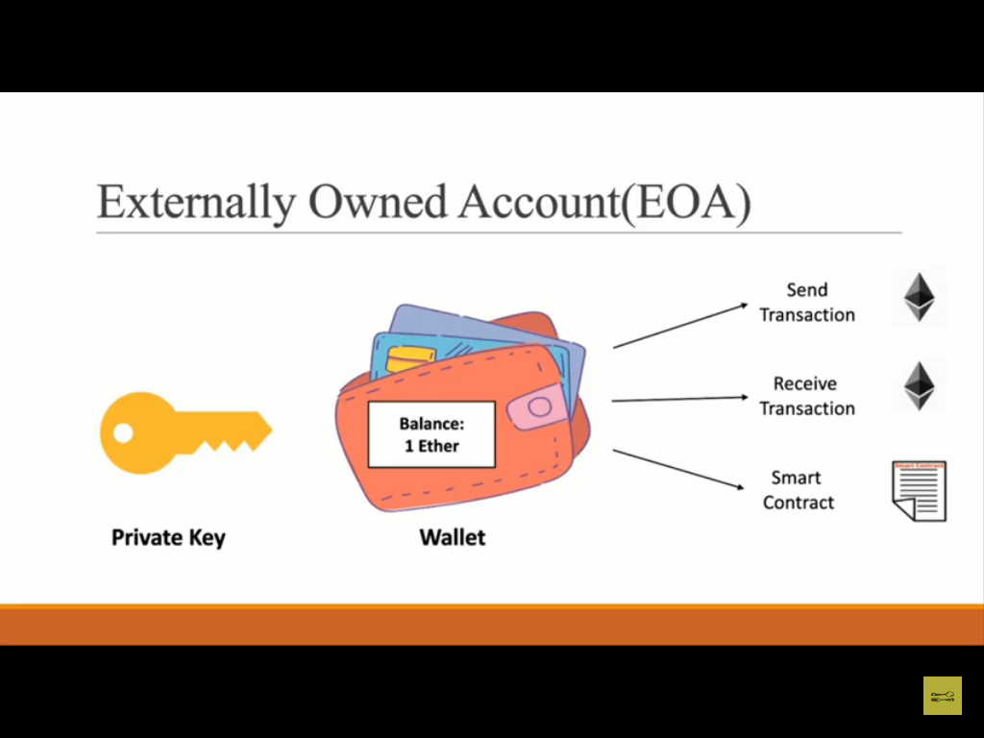

Slide 34
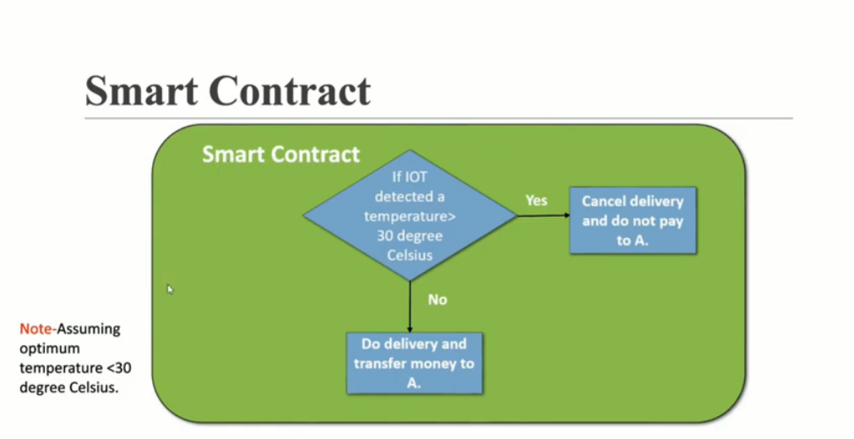

Slide 35
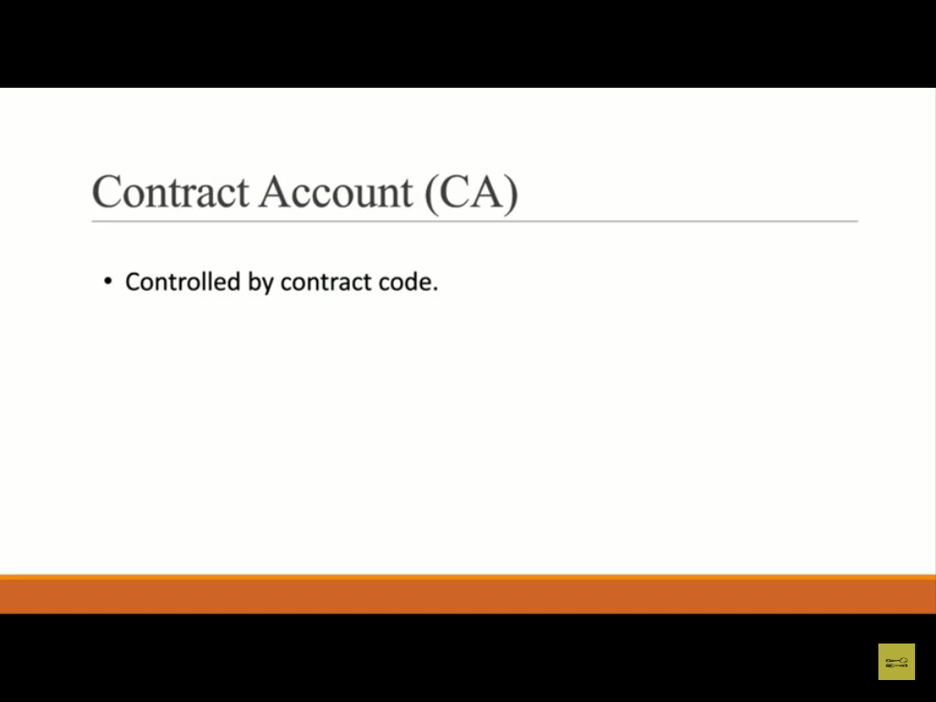

Slide 36
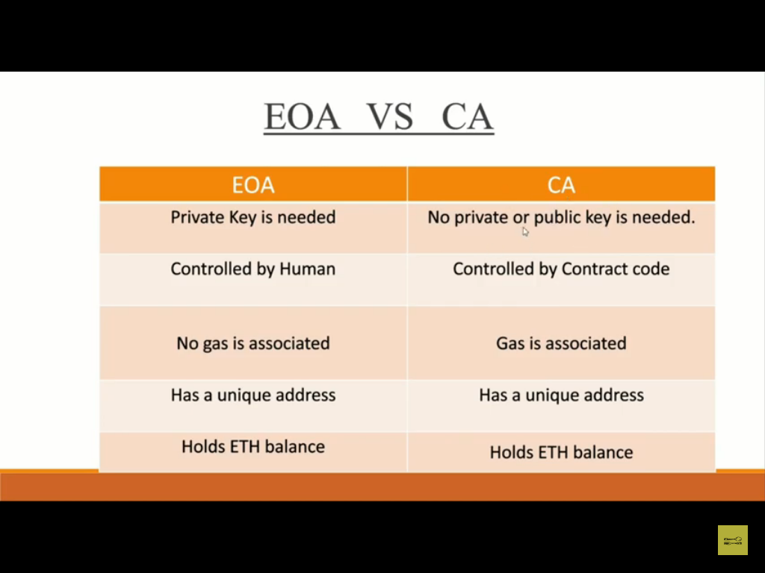

Slide 37
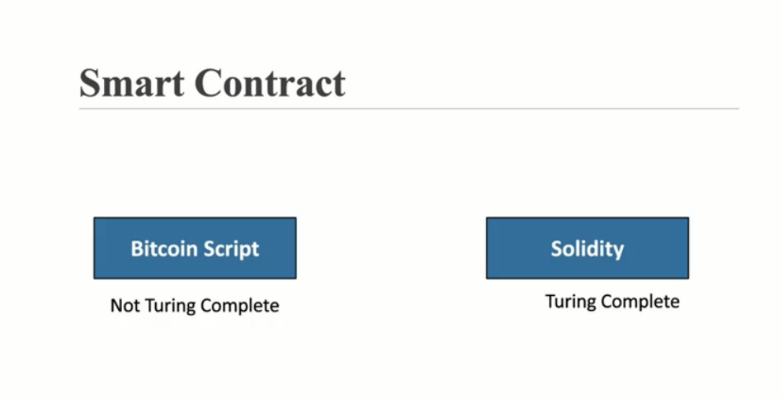

Slide 38
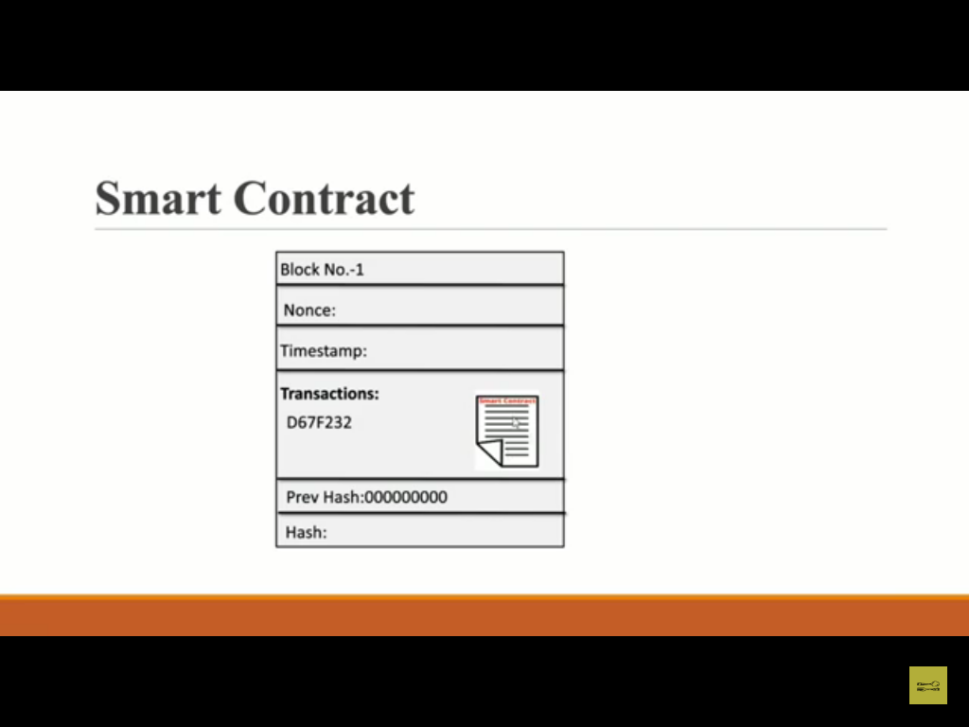

Slide 39
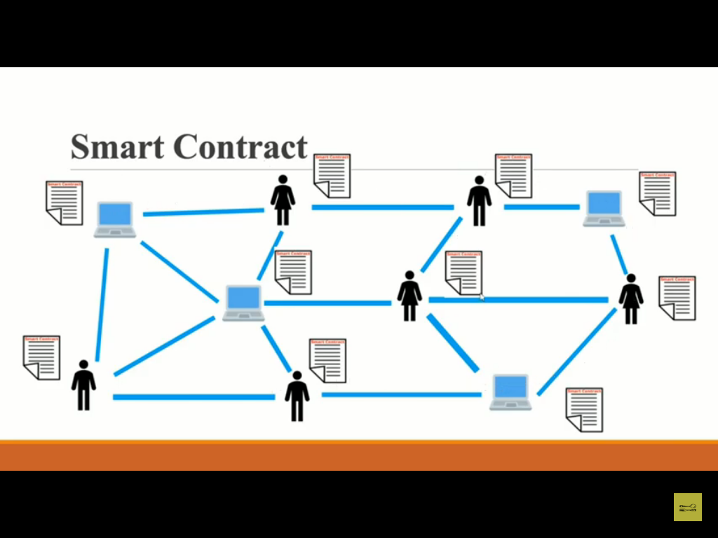

Slide 40
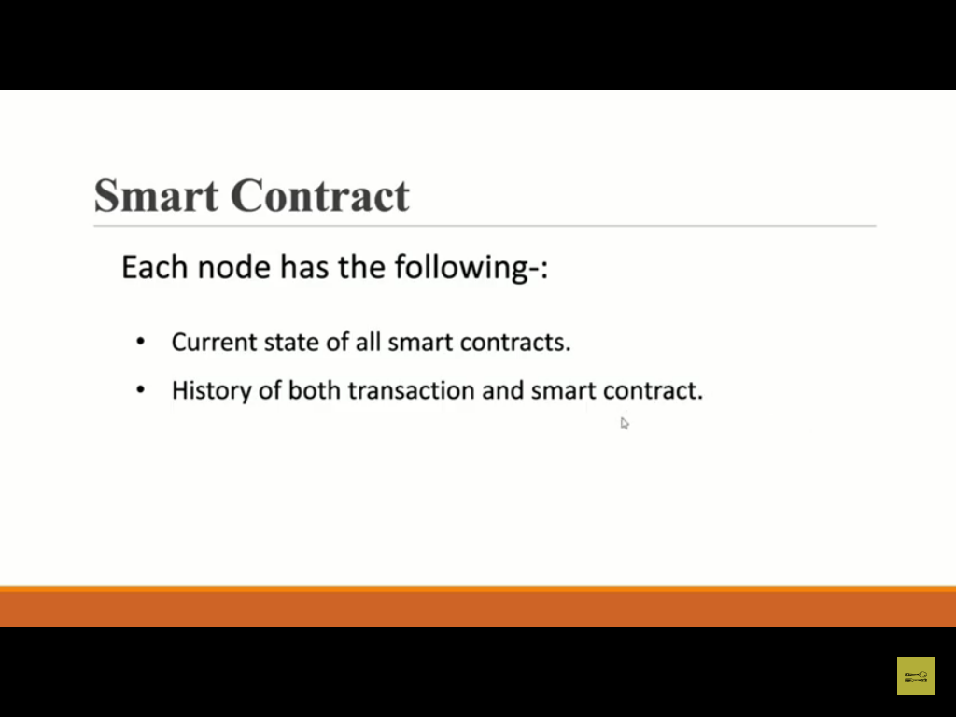

Slide 41
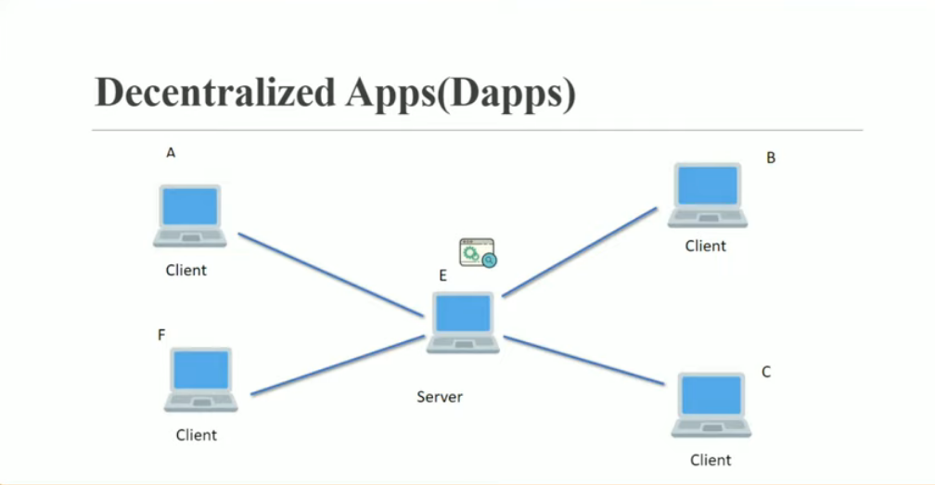

Slide 42
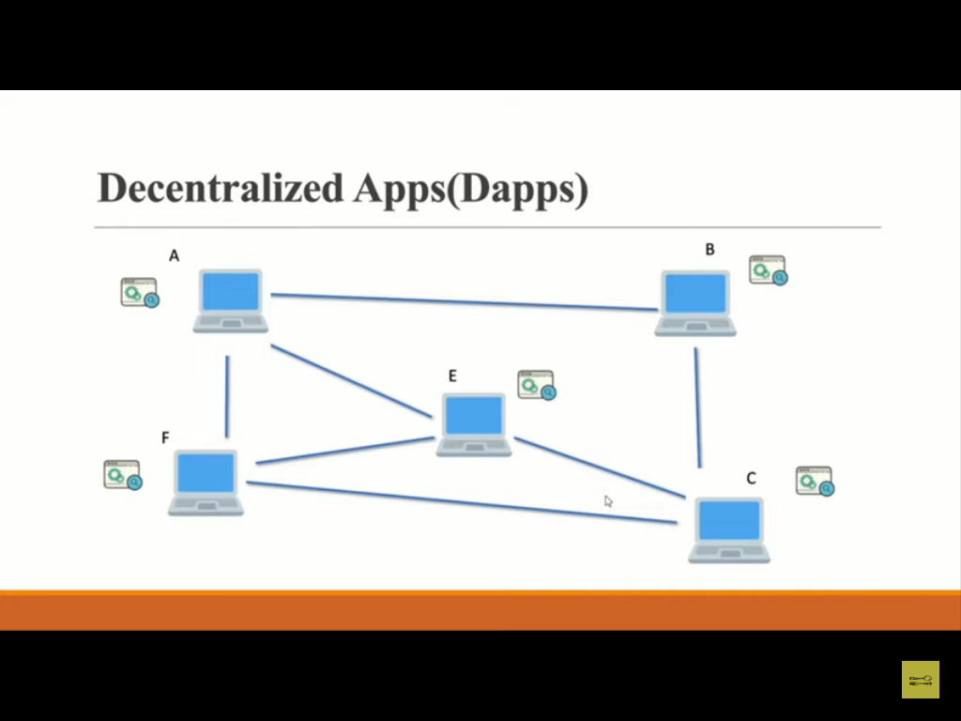

Slide 43
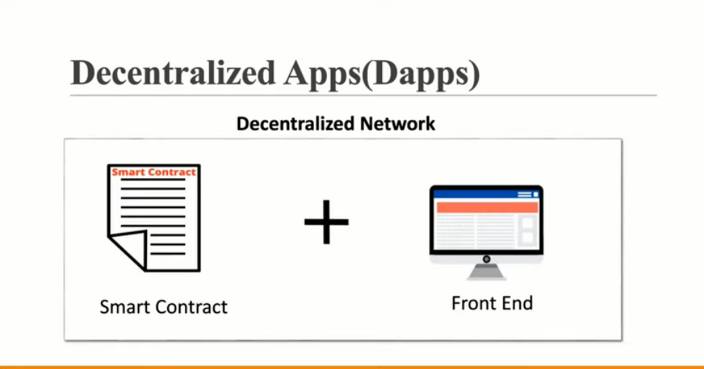

Slide 44
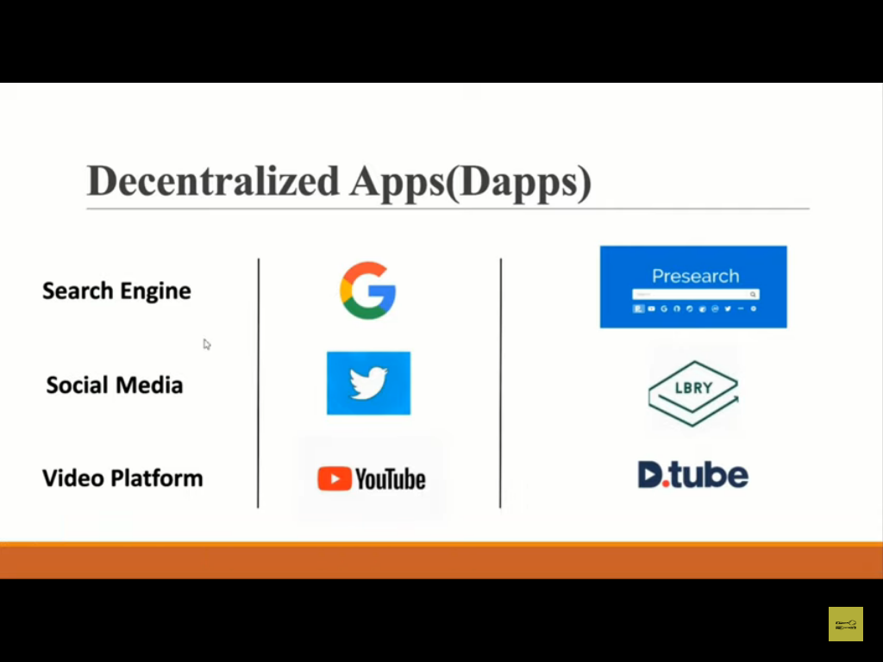

Slide 45
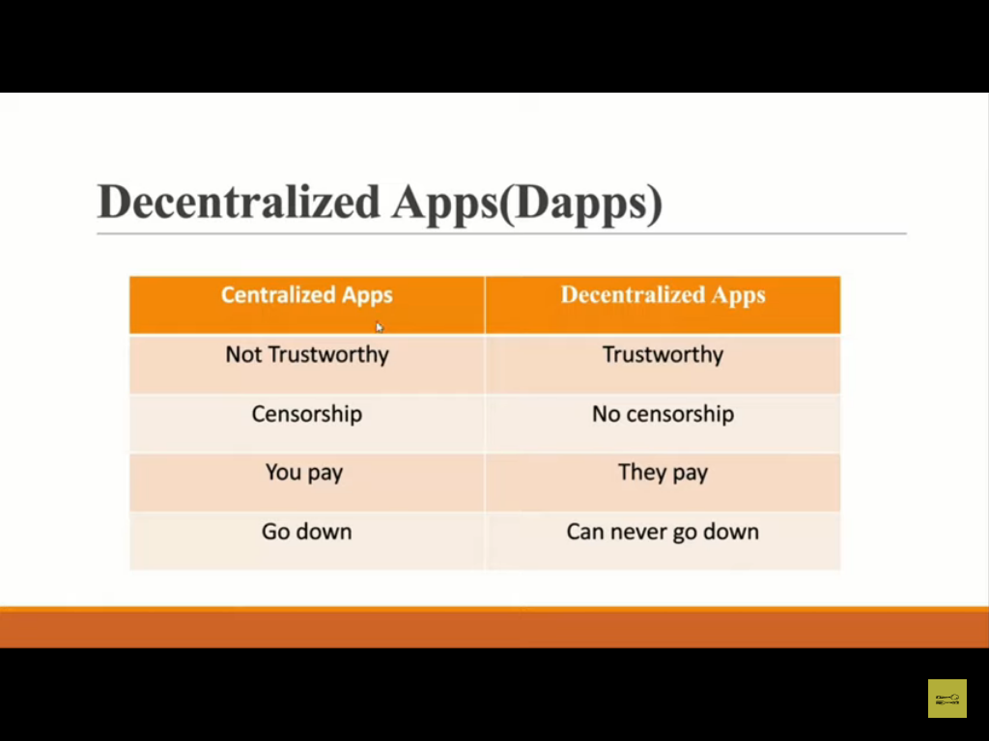

Slide 46
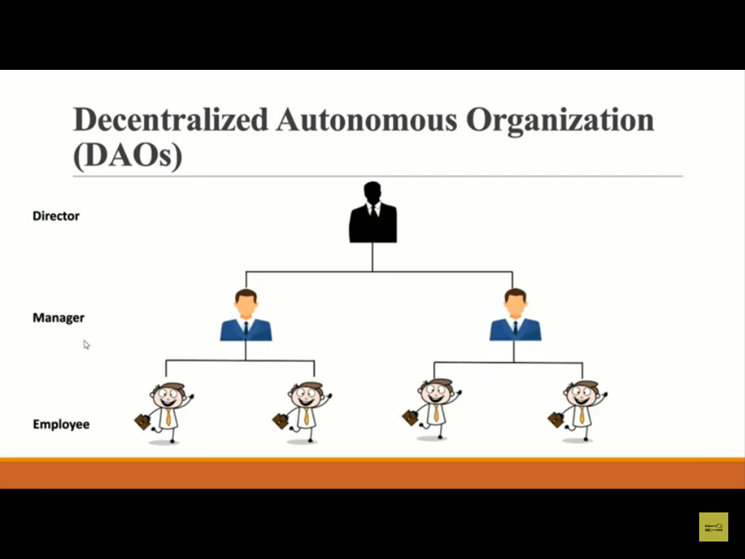
Ethereum Blockchain
Ethereum could be your do-it-yourself platform for most decentralized programs, also referred to as DApps – de-centralized programs. If you would like to produce a brand new application that no person controls, perhaps not you personally, though you wrote it, then all you need to learn the Ethereum programming language named Solidity.
The Ethereum platform includes 1000s of computers, meaning it is fully decentralized. Once a program is set up into the Ethereum system, the computers, also called nodes, are likely to make sure it implements as composed. Ethereum could be your infrastructure for executing DApps global. It may not be just a currency; it is a platform.
People can purchase cryptocurrencies from others without needing a market which may be subjected to unethical hacking. Ethereum’s programming terminology, Solidity, can be utilized to publish "Smart Contracts," which can be the logic that executes DApps.

Slide 47
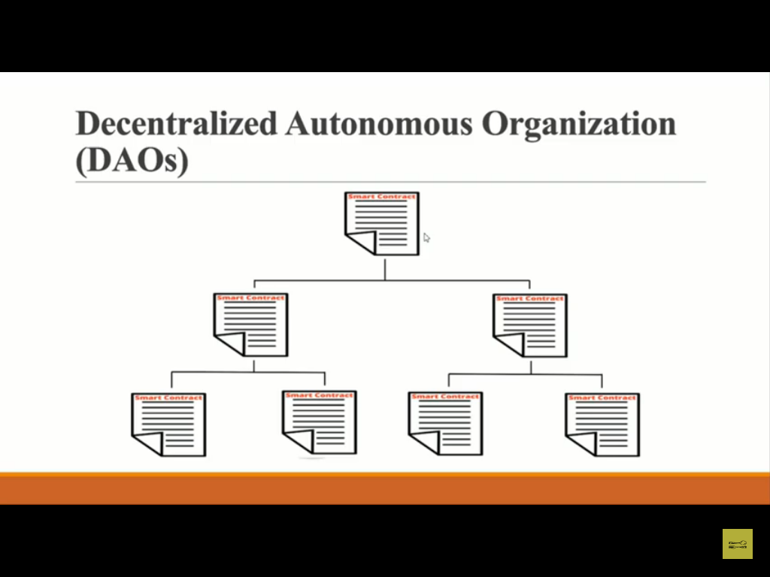
Introduction to Smart Contract
In real life, a contract is a set of "Ifs" and "Then." Meaning, a collection of conditions and actions. For example, if I pay my property owner $1,500 on the first of the month, then he lets me use his apartment. That is how smart contracts work with Ethereum.
Ethereum programmers write the requirements for their application or DApp, and the Ethereum network implements it. They are called smart contracts because they handle every facet of the contract – authorities, direction, performance, and payment.

Slide 48
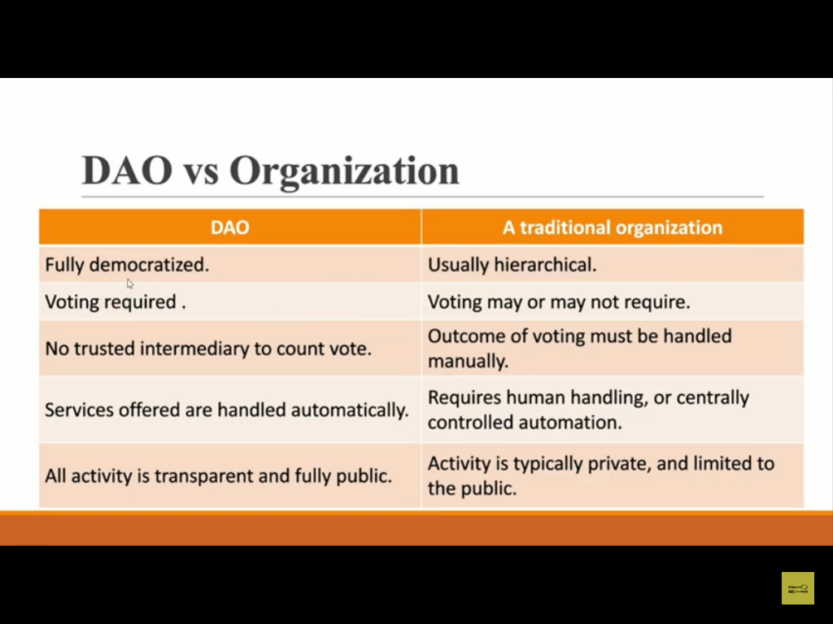
Code is Law
Ethereum started with the notion that “code is a law." In other words, a contract on Ethereum could be your ultimate authority, and nobody can overrule the contract.
"Dow" or DAO means “Decentralized Autonomous Organization," which enables users to deposit funds and receive returns dependent on the investments which the DAO made.

Slide 49
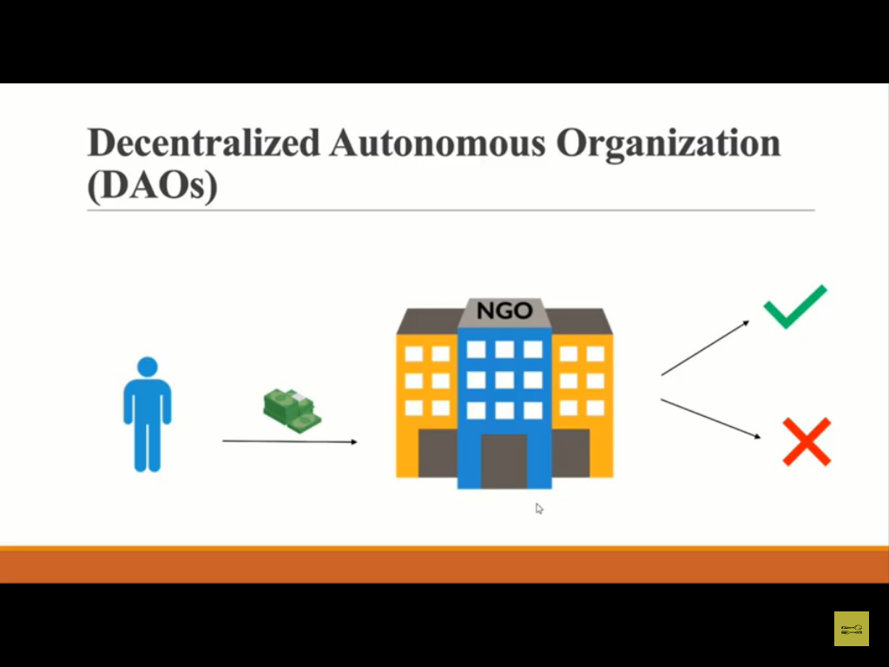
Ethereum Components
Miner and Mining Node
Ethereum Virtual Machine
Ether
Gas
Transactions
Accounts
Swarm and Whisper
Ethash

Slide 50
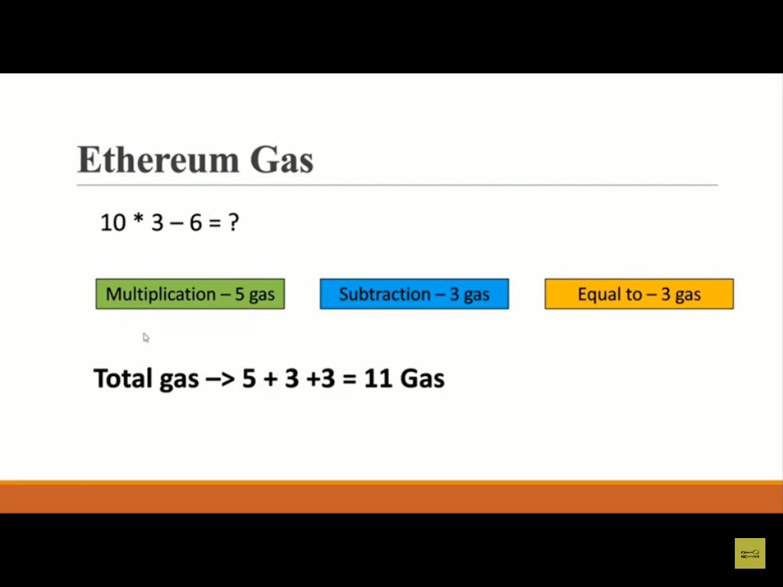

Slide 51
https://github.com/djrtwo/evm-opcode-gas-costs/blob/master/opcode-gas-costs_EIP-150_revision-1e18248_2017-04-12.csv

Slide 52
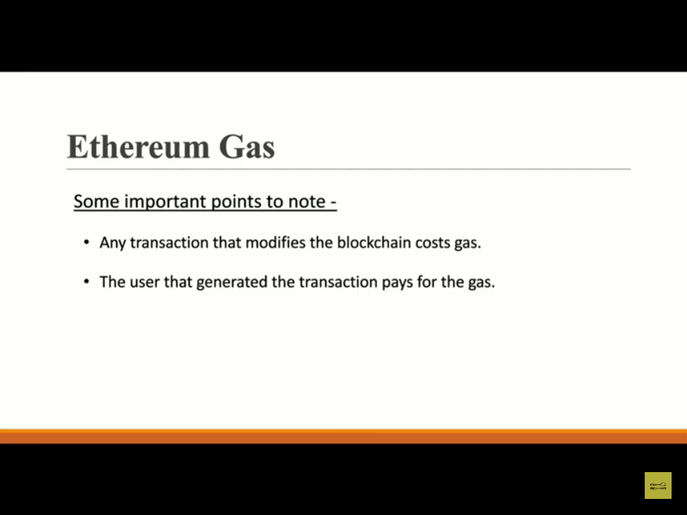

Slide 53
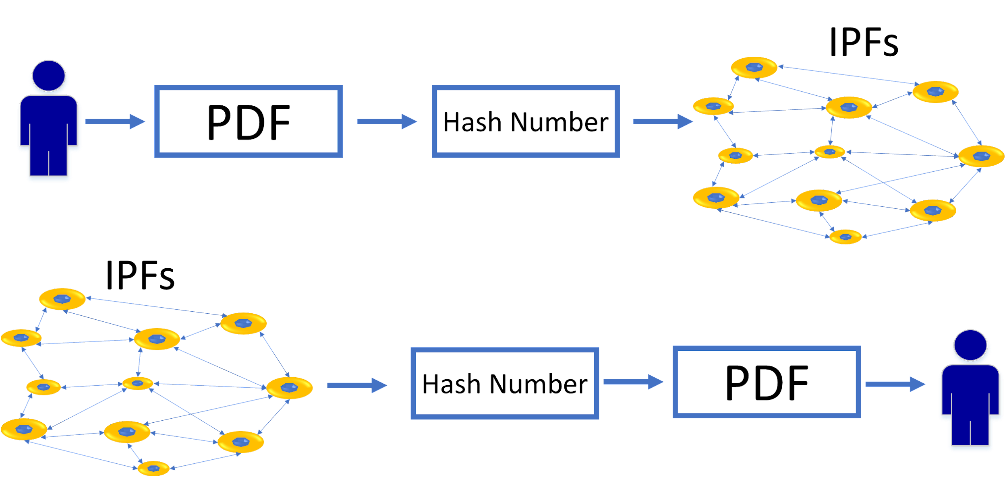
IPFs

Slide 54


Ethereum Characteristics
Cryptocurrency
Smart Contracts
DAO
DAO
Smart Property

Slide 55

EVM and Smart Contracts
Mining Nodes
Mining Nodes
Mining Nodes
Mining Nodes
EVM
SMART Contracts
Mining Nodes
Mining Nodes
Mining Nodes

Slide 56
Ethereum Transaction Fees
Transaction Fees = Gas Limit × Gas Price

Slide 57
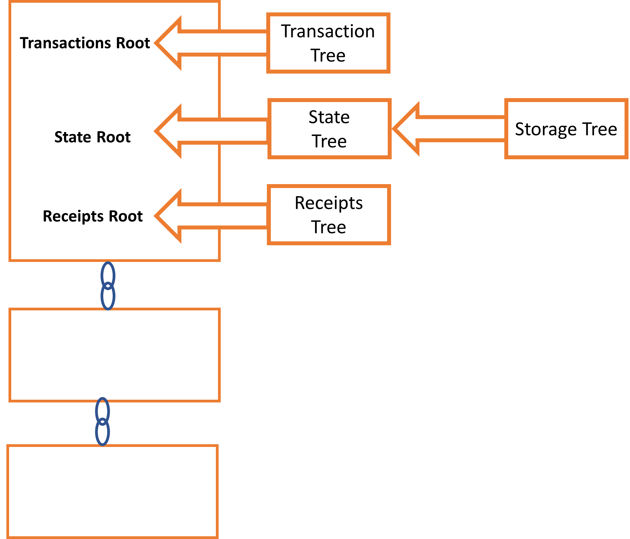
Ethereum Tree

Slide 58
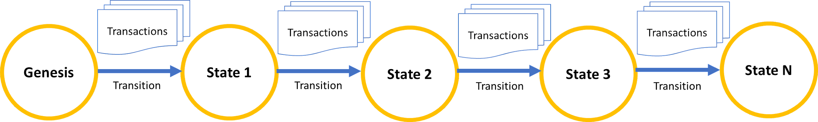
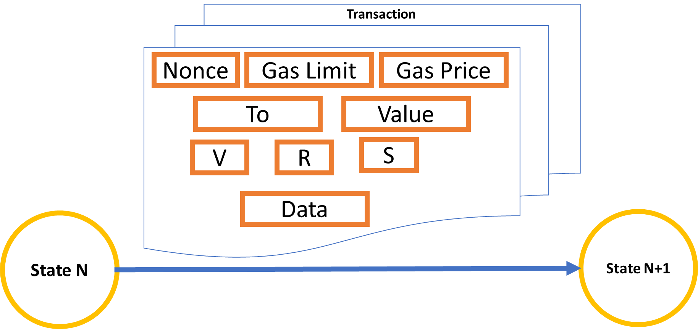
Components of Ethereum Transaction

Slide 59
Ether and Wei
Unit | Wei | Ether
Wei | 1 Wei | 10 ⁻¹⁸ ETH
Babbage | 1,000 Wei | 10⁻¹⁵ ETH
Lovelace | 1,000,000 Wei | 10⁻¹² ETH
Shannon | 10⁹ Wei | 10⁻⁹ ETH
Szabo | 10¹² Wei | 10⁻⁶ ETH
Finny | 10¹⁵ Wei | 10⁻³ ETH
Ether | 10¹⁸ Wei | 1 ETH

Slide 60
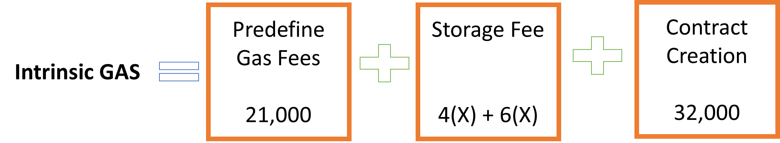
Intrinsic Gas Value

Slide 61
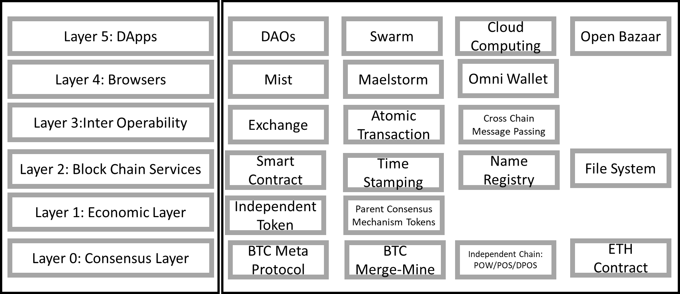
Architecture of Ethereum

Slide 62
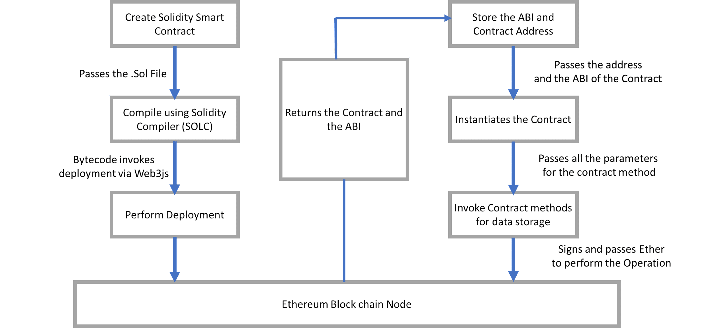
Workflow of Ethereum

Slide 63
Bitcoin Vs. Ethereum Comparison
 | BITCOIN | ETHEREUM
Founder | Satoshi Nakamoto(unknown) | Vitalik Buterin and Team
Purpose | Crypto Currency | Network Software
Release Date | January 2009 | July 2015
Scripting Language | Turing Incomplete | Turing Complete
Coin Release Method | Early Mining | Thru ICO
Average Block Time | Approx. 10 minutes | Approx. 15 second
Transaction Model | UTXO | Account
Coin Symbol | BTC | ETH
Tokens | Not available | Available
Monetary Policy | Hard Coded | Not Hard Coded
Emission Rate | Halving policy followed | Occasional
Backward compatibility | Available | Not Available
Block Limitation | 1 MB per block | No limit

Slide 64
TYPES OF SMART CONTRACTS
1. Smart Legal Contract
The most common type of smart contract, a smart legal contract, involves similar legal requirements (i.e.- mutual assent, expressed by a valid offer and acceptance; adequate consideration; capacity; and legality) to its traditional counterpart, and it is put in place to hold concerned parties accountable for fulfilling their end of an agreement.
When set up properly, a smart contract is legally enforceable and requires the parties to fulfill their obligations; failure to fulfill obligations in the contract may result in legal action that can be automatically triggered by the smart contract against the party that is in breach.

Slide 65
2. Decentralized Autonomous Organizations
Decentralized Autonomous Organizations, or DAO, can be defined as communities that exist on the blockchain.
These communities can be defined by a set of agreed upon rules which are coded via smart contracts. Every participant and their actions are subject to the community’s rules with the task of enforcing these rules.
These rules are made up of many smart contracts and work together to watch over activities in the community.

Slide 66
3. Application Logic Contracts
Application Logic Contracts—or ALCs—contain an application-based code that remains in-step with other blockchain contracts.
They enable communication across different devices, such as the merging of the Internet of Things (IoT) with blockchain technology. ALCs are a pivotal piece of multi-function smart contract and mostly work under a managing program.

Slide 67
Structure Of A Smart Contract In Ethereum
classes in object-oriented languages and Contracts in Solidity are very same . all contract could consist of State Variables, Modifiers and functions, Events, Struct Types and Enum Types. moreover, you can use other contracts. using inheritance.
In Ethereum blockchain ,transactions are implemented via smart contract code,which is activated by the data and inputs from external account automatically .
When external account triggers the smart contract ,the business logic within the contract gets executed and status of ledger balances of all the accounts gets updated .This is also gets updated on all the nodes in blockchain.

Slide 68
The data gets written on all the nodes while writiing but during reading ,it is only from the nearest or adjacent node.
Hence more efforts and resources are involved in writing and updating the information in Ethereum blockchain .
To pay the reward for this work ,Gas concept is used .
It is a conversion unit of “ether” which is native currency of Ethereum blockchain.

Slide 69
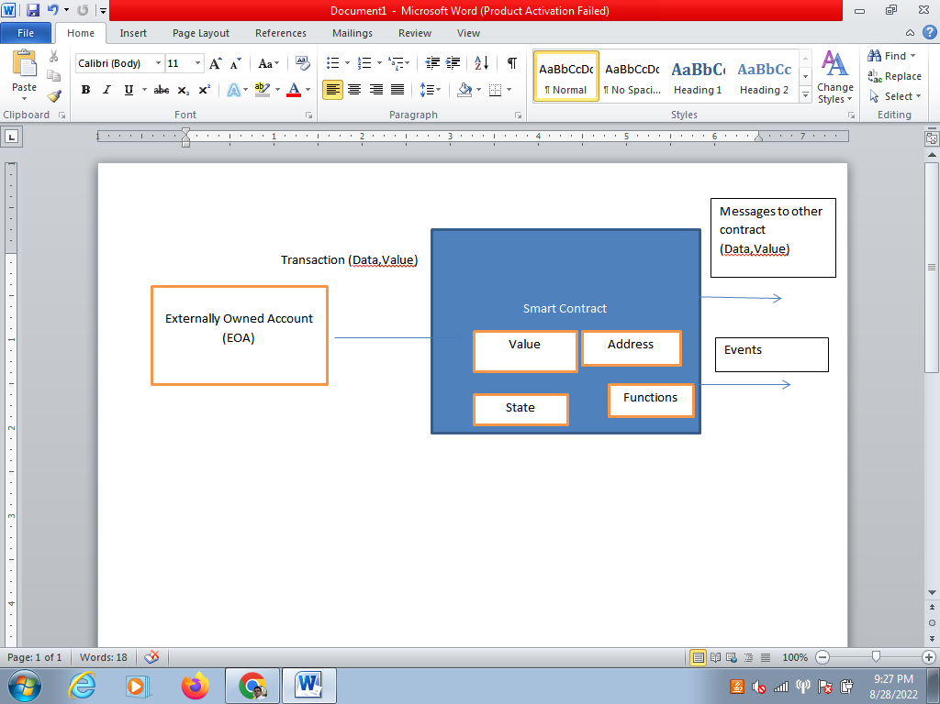

Slide 70
A smart contract contains the value ,address ,functions and state .
The input to the smart contract is transaction.
With this input it executes the corrosponding code and triggers the output events.
A smart contract is a software program that resides on a Blockchain and it has its unique address.
Smart contract is identified by this unique address.
A smart contract contains a set of executable functions and state variables.
The execution of the function happens when transactions are made to these functions.
The transactions contain input parameters which are needed by the functions in the contract.
When function executes the state variables in the contract changes depending on the logic implemented in the function.

Slide 71
Contracts are written in various high-level languages like solodity or python.
Language specific compilers are used to compile the smart contract code into byte code.
The compiled code of contract is uploaded to the blockchain network which assigns unique addressee to the contract .
Any participant or member on the blockchain network can trigger the functions in the contract by sending transactions to the contract.
The contract code runs on each node participating in the network as part of the verification of new blocks

Slide 72
Let’s take a look at very basic smart contract structure which has written in Solidity.
pragma solidity ^0.4.2;
contract Customer{
string id;
function setId(string serial) public {
id = serial;
}
function getId() public constant returns (string) { return id;
}
}

Slide 73
Benefits of Smart Contracts
Smart contracts are much more than digital versions of paper-based contracts. Organizations can use smart contracts to automate the contract lifecycle, improve collaboration, and digitize their assets or transactions
1. Security
Smart contracts use data encryption and are tamper-proof, making them a highly secure alternative to paper-based contracts. Due to high-level security, smart contracts have the potential to be used in financial institutions and government offices.
2. Speed
Automation of contract lifecycle process and the self-enforcement capability of smart contracts speed the process considerably. Automation of the CLM process makes it less prone to human error.

Slide 74
3. Fewer Intermediaries
There’s a reduced dependence on intermediaries for trust services like escrow between the counterparties.
4. Transparency
Smart contracts ensure higher transparency and hence a lower execution risk. Any amendment to the contract can require the mutual consent of the involved parties.
There is no scope of manipulation or non-performance due to any individual.
5. Cost-Effective
Unlike paper-based contracts, smart contracts are highly cost-effective because of reduced dependence on intermediaries and ease of storage.

Slide 75
Limitations of Smart Contracts
While there are plenty of reasons to adopt smart contracts, there are a few reasons to not. Here are a few of the challenges and limitations associations with smart contracts to consider before making the change.
1. Flexibility
Logic-based execution is often challenging for law firms. Contract creation has a subjective element in it and has intentional usage of terms like ‘good faith’ or ‘reasonable’ or ‘best endeavors to have room for flexibility. This type of contract is required when the parties want to create a relational contract instead of a transactional one. In such scenarios, smart contracts fail to offer utility.
2. Legal Ramifications
Since smart contracts reduce dependence on intermediaries and lawyers, it’s imperative for involved parties to be aware of the legal ramifications of public, private, criminal, and mercantile law.

Slide 76
3. Delayed Transactions
There are cases where technology proves to be a bane rather than a boon. One such instance is that congestion in a blockchain network can result in a delayed transaction and eventually push transactional cost above the cost incurred in traditional contracts.

Slide 77
Uses Case for Smart Contracts
Smart contracts are finding applications across industries. However, the low-hanging fruits for these contracts are applications in which contracts are narrow, objective, and mechanical. Agreed-upon clauses are straightforward and have clearly defined outcomes.
A few of the prominent legal use cases are as follows:
1. Intellectual Property Rights
With increased digitalization, intellectual property thefts have increased, which is impacting the livelihoods of authors, artists, and inventors. Blockchain-based smart contracts leverage non-fungible-tokens (NFTs), which are cryptographic tokens used to represent the unique property. This technology allows users to upload and register their work with time stamps on a public ledger to create irrefutable proof of ownership.
2. Property Rights
The real-estate sector is relatively less organized and has a high dependence on intermediaries. The property owner can utilize blockchain architecture to bypass these intermediaries and register their properties on a public ledger. Additionally, they can sell their properties in a transparent and immutable way to save on transactional costs.

Slide 78
3. Chain of Custody
It is the evidence handling process from obtaining a piece of evidence to presenting it in court. During this time-frame, the evidence is handled by multiple people and can easily be tampered with.
Leveraging blockchain technology allows users to monitor the evidence in real-time by generating and tracking a unique evidence token for every item of data collected and stored. This creates a level of transparency and data integrity.
4. Electronic Signatures and Notarization
Electronic signatures speed up the approval process. Currently, most organizations are leveraging platforms like DocuSign or AdobeSign.
Blockchain-based smart contracts reduce the cost associated with e-signatures to a fraction of the original cost. It makes the notarization process more trustworthy through document authentication and signature verification with time stamps and hashes.

Slide 79
https://techblog.geekyants.com/e-voting-via-blockchain-a-case-study

